Slide 1
SUICIDE DATA VISUALIZATION
TAUHID RAHMAN
ID: 1510449042
SEC: 02

Slide 2
MID PROJECT UPDATES
We found the dataset from kaggle.
I , first added the Python libraries which are vital for the project like : 1. Numpy
2. Pandas
3. Scikit
4. Keras
5. Tensorflow
6. Matplotlib
I previously had little knowledge about the project and python so hardwork was needed for progress

Slide 3
MID PROJECT UPDATES
With the dataset , I tried many tricks that I learned from class and internet like I found how to get correlation plot, visualizing the different countries distribution in the dataset, visualizing the different year distribution in the dataset, label encoding, visualizing gender distribution in the dataset, suicides in different age groups, total number of suicides committed, splitting the data into dependent and independent variables, splitting the dataset into training and testing sets and tried to implement linear regression algorithm and tried many more commands..

Slide 4
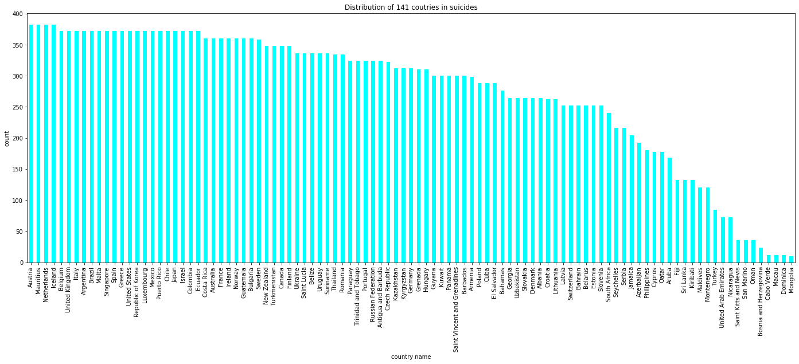
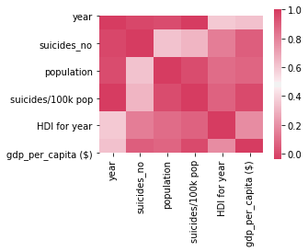
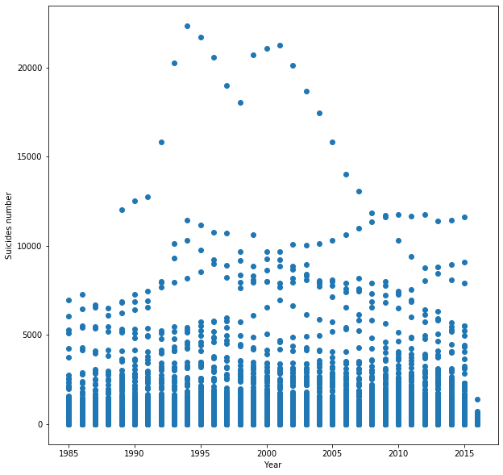
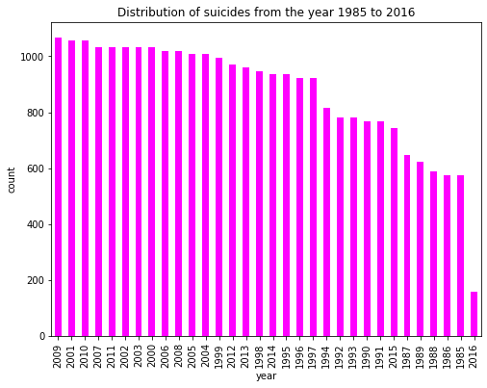
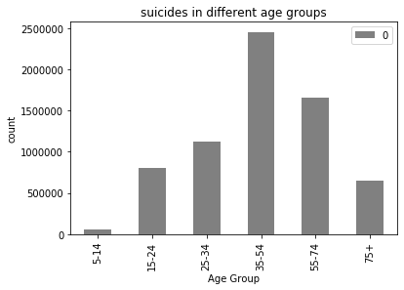
MID PROJECT UPDATES
THE OUTPUTS:

Slide 5
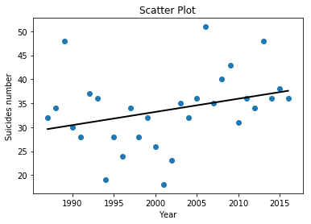
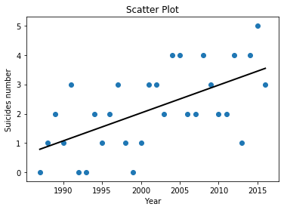
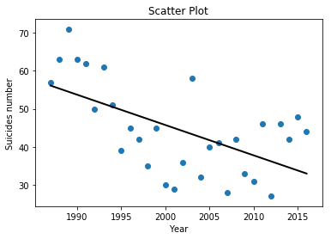
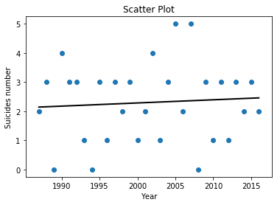
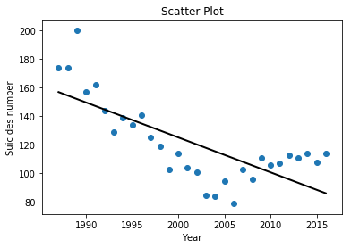
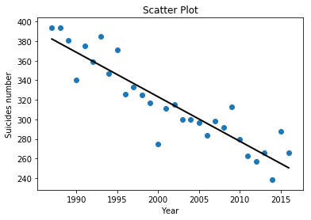
MID PROJECT UPDATES
OUTPUTS: Scatter plots of suicides for female and male in different ages using linear regression.

Slide 6
FUTURE WORKS
For future works I would like to try to implement algorithms like CNN, RNN , SVM to predict the suicide rates from the dataset.
Then I would choose the best fitted algorithm and present it in the final updates of the project

